Slide 1
Digital System Design CE 325 L1 SPRING 2024
Instructor : Dr. Syed Arsalan Jawed
Associate Professor of Practice
arsalan.jawed@sse.habib.edu.pk
Room : W-301
Office Hours : Monday 0930-1030, Wednesday 1430-1530, Friday 0930-1030

Slide 2
Synthesis with and without Scripts using Simple Counter Example
module counter(clk,
reset,
count_out);
input clk, reset;
output [3:0] count_out;
reg [3:0] count_out;
always @(posedge clk)
begin
if(reset)
count_out <= 4'b0000;
else
count_out <= count_out + 4'b0001;
end
endmodule
Gate Level Netlist
/* Generated by Yosys 0.39+163 (git sha1 040605b04, x86_64-w64-mingw32-g++ 13.2.1 -Os) */
(* top = 1 *)
(* src = "counter.v:1.1-17.10" *)
module counter(clk, reset, count_out);
(* src = "counter.v:14.18-14.37" *)
wire [3:0] _0_;
(* src = "counter.v:5.7-5.10" *)
input clk;
wire clk;
(* src = "counter.v:6.14-6.23" *)
output [3:0] count_out;
reg [3:0] count_out;
(* src = "counter.v:5.12-5.17" *)
input reset;
wire reset;
assign _0_ = count_out + (* src = "counter.v:14.18-14.37" *) 4'h1;
(* src = "counter.v:9.1-15.4" *)
always @(posedge clk)
if (reset) count_out <= 4'h0;
else count_out <= _0_;
endmodule

Slide 3
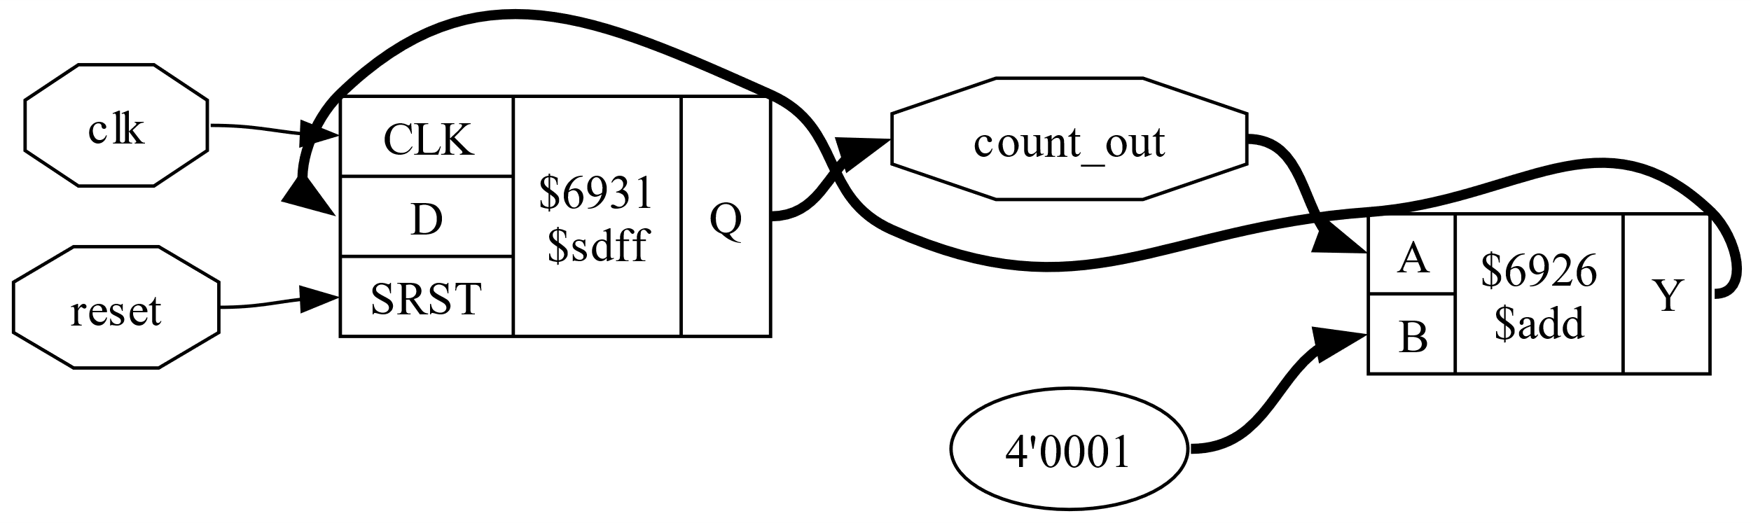
Without script and without TECHMAP
Read design,
Hierarchy set top,
proc,
optimize

Slide 4
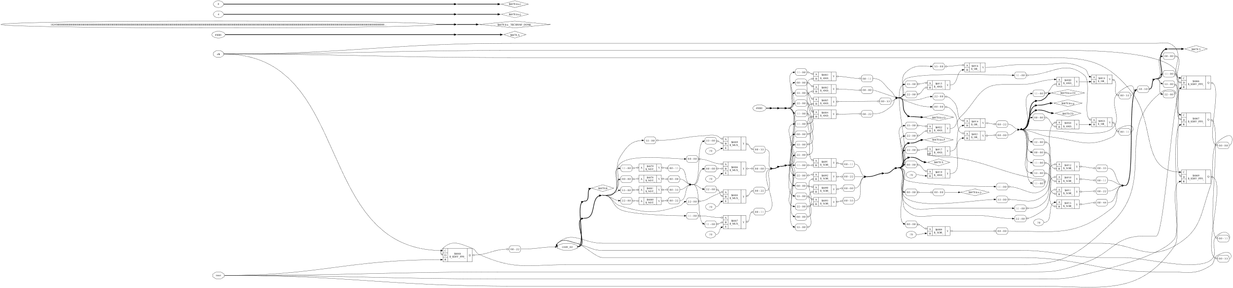
Without Script – With TECHMAP

Slide 5
With Synthesis Script Synth
Read_Verilog counter.v
Synth
Show
Convert to svg and display

Slide 6
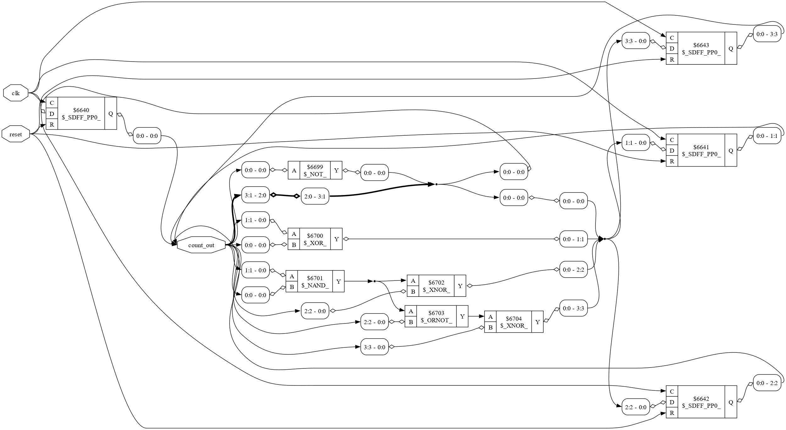
Synth Script without Techmap

Slide 7
Synth Script with Techmap

Slide 8
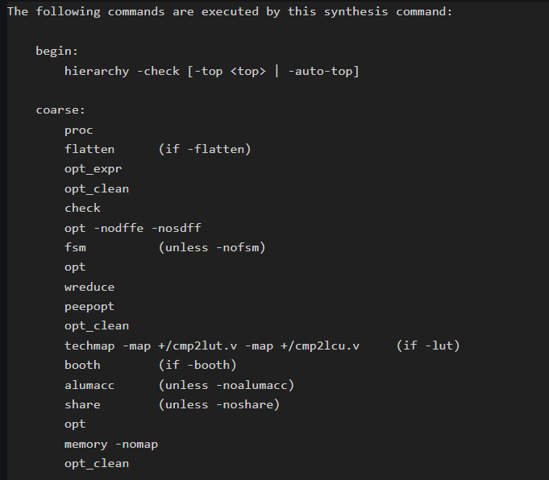
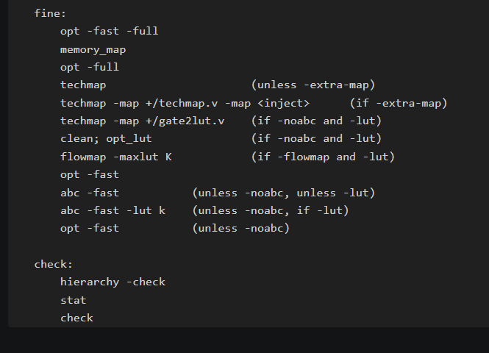
Synth – Generic Synthesis Script How Synth getting better results? Using multiple Optimizations, let us try separately.

Slide 9
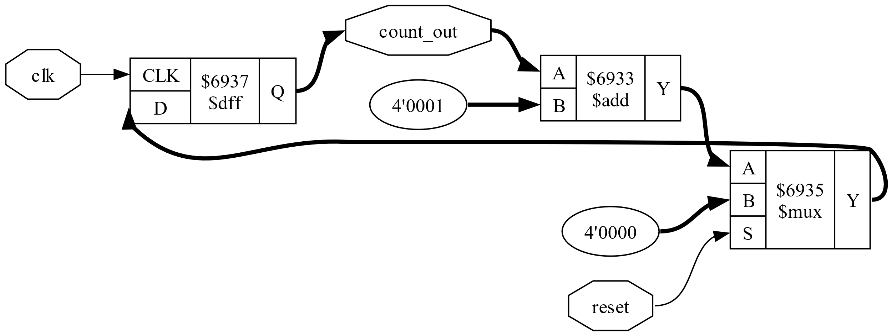
Counter with Opt_expr and opt_clean after Proc
Significant Improvement, similar to Synth Script
What does Opt_Expr does?
opt_expr [options] [selection]
This pass performs const folding on internal cell types with constant inputs. It also performs some simple expression rewriting.

Slide 10
Use Synth Script & your own script with opt_expr, opt_clean for your own FIFO
This would be the last assignment launched this week.

Slide 11
Changing Course Project Slightly
Introducing OpenLane Tools from Efabless
The project would be based on PnR of your FIFO.

Slide 12
Install Ubuntu through WSL on Windows
Wsl -- install
Wsl -- update
Wsl – install –d Ubuntu
(Enable option in Windows settings to use WSL)
Launch Ubuntu from Windows

Slide 13
Clone Open on Ubuntu
Go to home folder
Solve library dependencies on the go.
You need to install Docker Container
Refer to the following link for the required packages:
https://openlane.readthedocs.io/en/latest/getting_started/installation/installation_win.html#installation-of-required-packages
Deadline for installation : 15th April
3 Marks in Class Performance
cd $HOME
git clone https://github.com/The-OpenROAD-Project/OpenLane
cd OpenLane
make
make test
./flow.tcl –design spm

Slide 14
Will Run Timing Constraint Introduction to Synthesis with OpenLane

